Slide 1
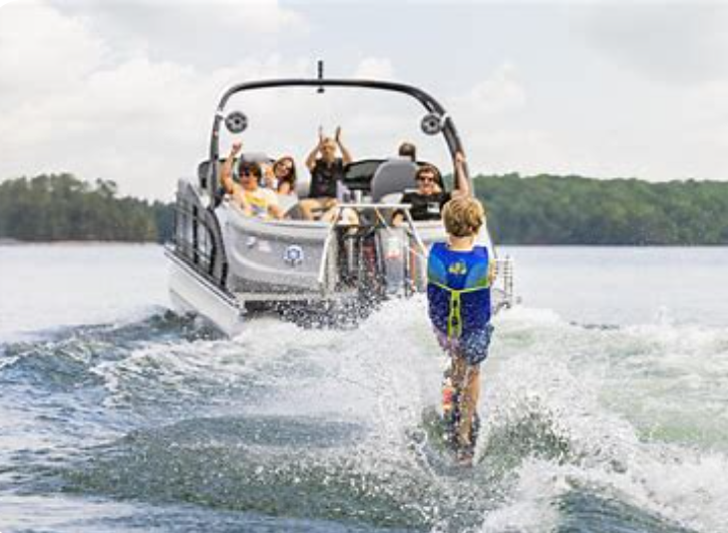
Boating Safety & Etiquette Orientation
Prepared by CARE Committee
June 2024

Slide 2
ILPOA Mission
The Indian Lake Property Owners Association exists to preserve our shared resources and build community amongst our members
ILPOA Vision
We pledge to work together to protect and enhance the lake community for the enjoyment of present and future generations. We are committed to preserving the health of the lake and maintaining the roads, infrastructure, and common areas of our community
Our Values & Guiding Principles
Community Enhancement
We are a volunteer association working to improve our community for all members
We will work to promote activities and togetherness in our community
Relationship Building
We are responsive to our community’s needs through our relationship with our neighbors, community businesses, and organizations in Crawford County and the State of Missouri
Safety Focus
We will ensure that safety is a priority and practiced by all members of our community
Open Communication
The Association operates as a conduit of information, and we are committed to providing timely information to our members
We will offer opportunities for our members to bring forward concerns, and work collectively with all the resources available to resolve
Notes:
Mission – why do we exist? Preserve resources . . . No lake, no roads, no reason to come here – property values tank
Vision – what is our desired future state? we want enjoy and future generations to enjoy . . . Well then we have to be committed to the vision
Values – what are our guiding principles? Improve our community, ensure safety, open communication

Slide 3
Introduction . . .
Proposed Training Schedule
Saturday June 1, 2024 – 9:00 to 9:45 am
Reference Materials
Presentation
IH Rules
MO Water Patrol
“The Handbook of Missouri Boating Laws and Responsibilities”
www.boat-ed.com/Missouri/handbook
Presenter
Kori Saake, Dave May
Attendees
Interested Members, BOD, CARE, Lake Patrol, Security
ILPOA has over 1,000 watercraft which has created a direct impact on the lake traffic, lake restoration, wave activity, and lake safety.
With effort, we can all play a role in improving these issues.

Slide 4
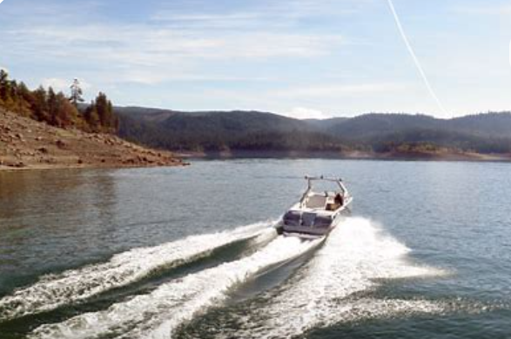
Objectives . . .
Educate Members on Boating & Watersport Safety
Members Awareness of IH Rules
Education for Members to Share with Family, Guests, and Neighbors
Handout Information and Make Available at ILPOA Website
Boat with empty ballast tanks

Slide 5
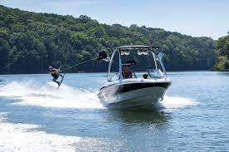
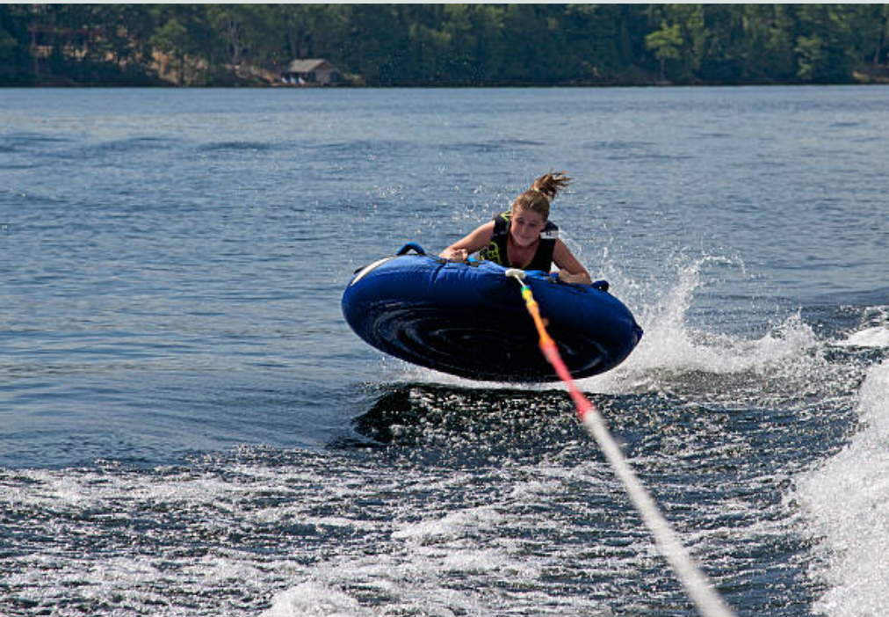
IH Boating Rules (Summarized) . . .
Wake Boarding
Counterclockwise Rotations
Except Picking Up Skiers
10:00 am to 7:00 pm Boating & Watersport Operation
After Hours 5 mph – no wake
Approved PFD (Personal Flotation Device)
For each person on the boat and in tow
Motorized Watercraft Operate at Minimal Speed Within 100 ft of:
Non-motorized Boats, Swimmers, Fisherman, Buoys, and Docks
Never Tow Closer than 100 ft to any Non-motorized Boat, Object, or Person.
100 Foot Distance Reference
5 Times Boat
Length
Tubing

Slide 6
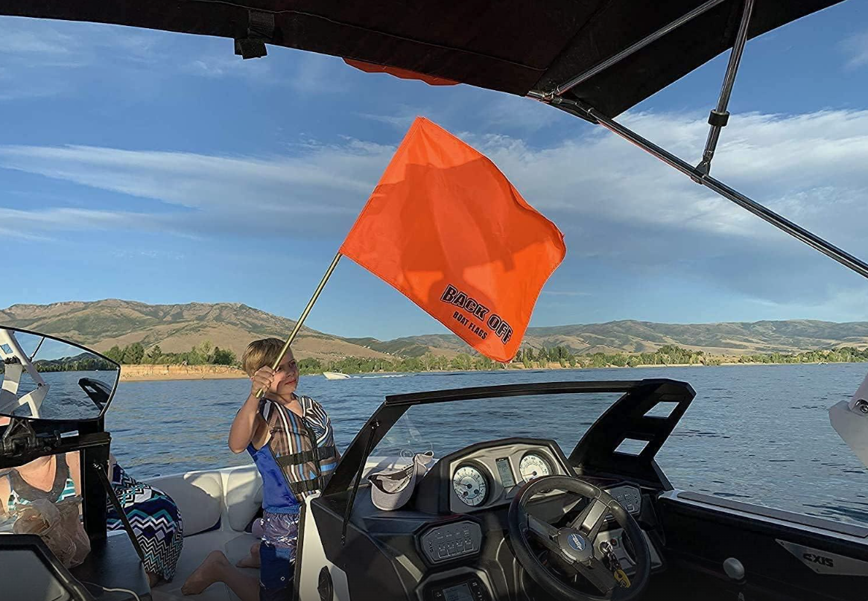
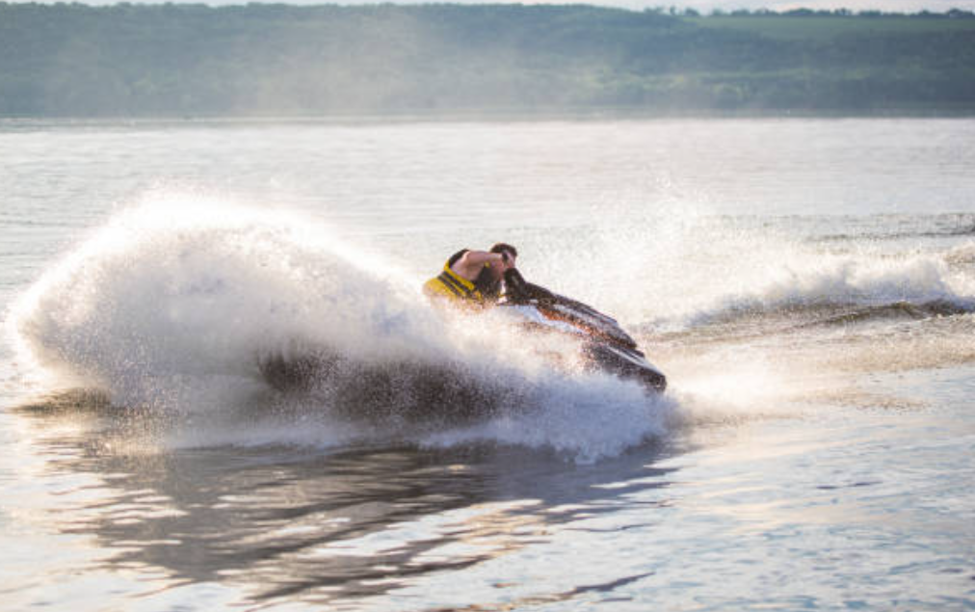
IH Boating Rules (Summarized) . . .
Speed Limit Maximum 40 MPH
5 mph or at minimum wake non-hours - 7:00 pm to 10:00 am
Towing – Skiers, Tubing, Wakeboarding
50ft minimum rope, 100ft distance, raised orange flag for down skier
Reckless and Negligent Operation of Boats is Prohibited
Not Allowed – Artificial Weight
Water Sacks, Coolers, Weight Devices, Wedges
Negligent Operation of Watercraft – Excessive Wake
No Method of Boat Operation to Artificially Create Excessive Wakes
100 ft Distance
1-1/2 times rope distance
5 times length of boat

Slide 7
Missouri State Water Patrol Rules . . .
MO Water Patrol At IH
IH is a private lake and MO Water Patrol Rules are not enforceable, but IH rules suggest compliance with rules.
MO Water Patrol will file a report upon a boating incident – therefore report can identify non-compliance to MO State Water Patrol Rules.
“The Handbook of Missouri Boating Laws and Responsibilities”
www.boat-ed.com/Missouri/handbook
Key MO Water Patrol Rules
All persons born after January 1, 1984, must have passed MSHP safety license.
Be responsible and get your MSHP safety license
Operate Boat or PWC at speeds not greater than “Idle speed” or “Slow”, “No Wake Speed” within 100ft of Dock, Boat, Buoy, Person
Alcohol and Drug – Zero Tolerance for boat drivers

Slide 8
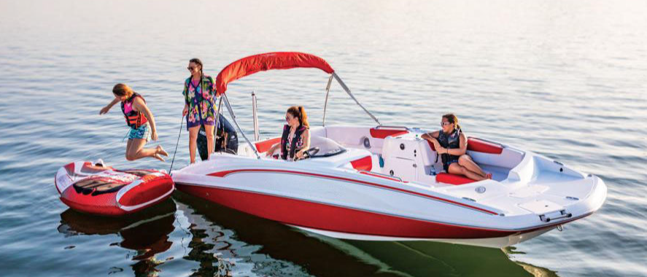
Citation Process . . .
IH water patrol has been trained for consistent enforcement of our IH rules.
Typically, verbal guidance or warning are the usual water patrol enforcement.
If a citation is issued , there is an established process for appeal of citations.
Citations may only be issued in non-compliance with rules.

Slide 9
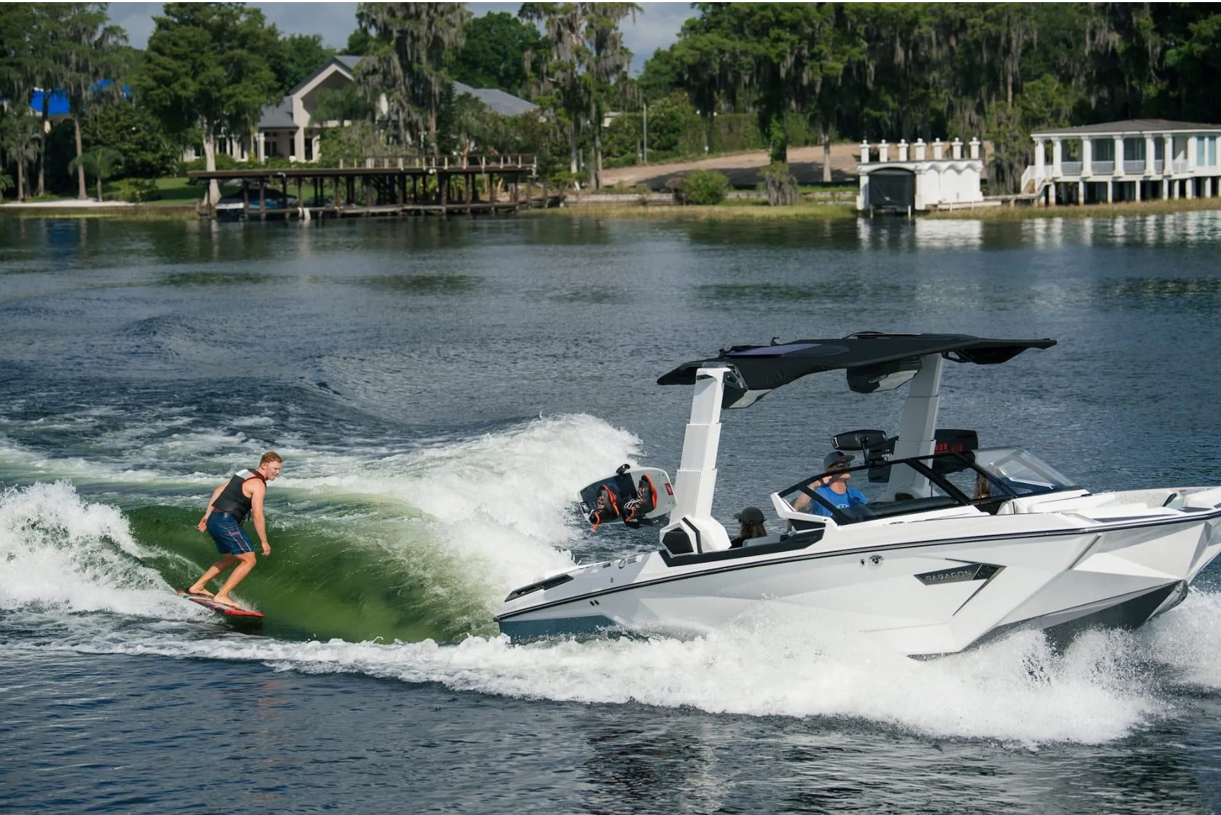
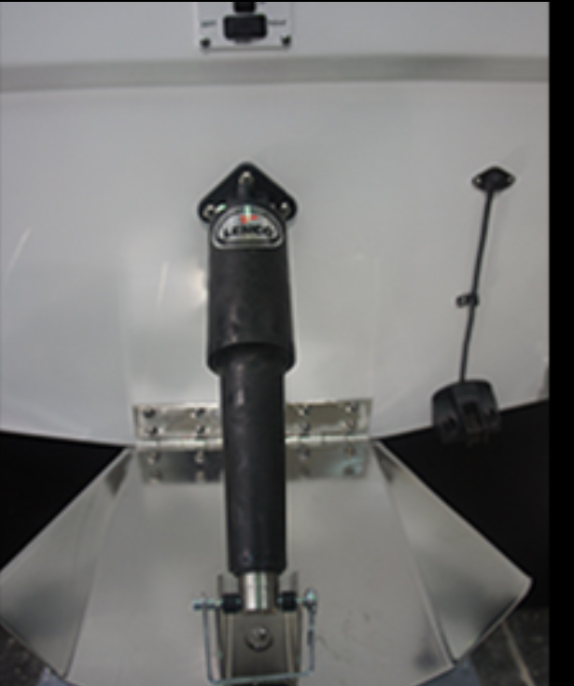
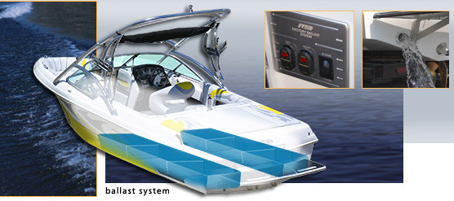
IH Non-Compliance Rule (Summarized) . . .
No Wake Surfing
Wake Surfing Defined as Riding in an Artificial Wave Created by a Boat
No Added Weight in Boat
Water Ballasts/Sacks/Lead or Concrete Weights
No Filling of Water Ballasts on Boats
No Wedges or Wake Trim Tabs to Enhance Wake
Wake Surfing
Water Ballast
Trim Tabs

Slide 10
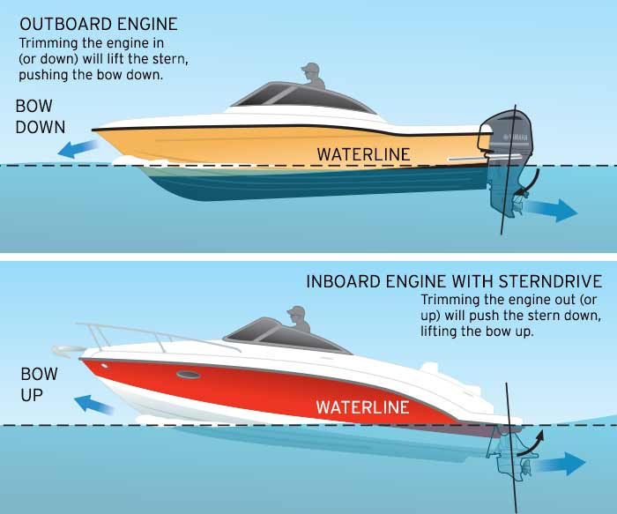
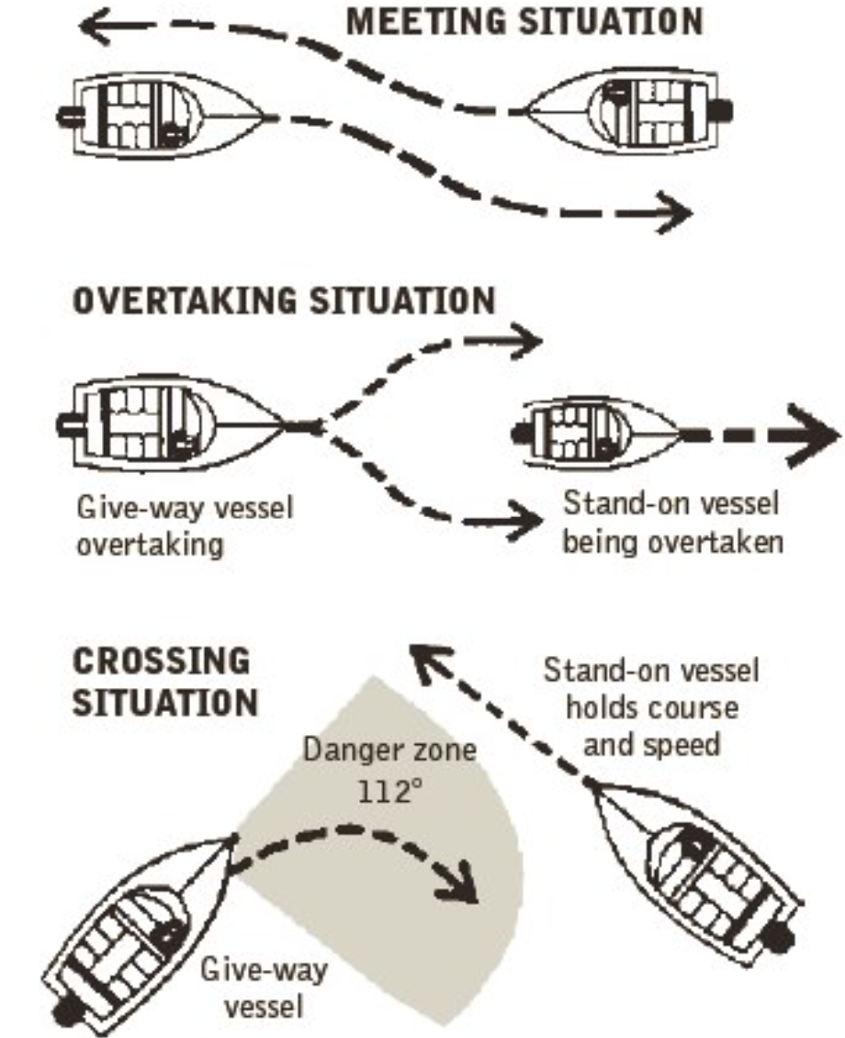
IH Good Boating Practices . . .
Be courteous of other boaters. Keep distance from swimmers, docks, and other items
Make sure you family and friends understand and follow these rules and guidelines
Accelerate you boat with a mindset to minimize wakes.
Cove parking – proceed cautiously
Promote “Boating Etiquette” among others in a friendly fashion.
Down person(s) hand up for safety
Tubing – during busy times minimize zig zagging
Boat Acceleration
Boat Operation

Slide 11
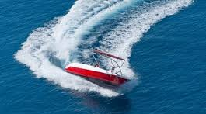
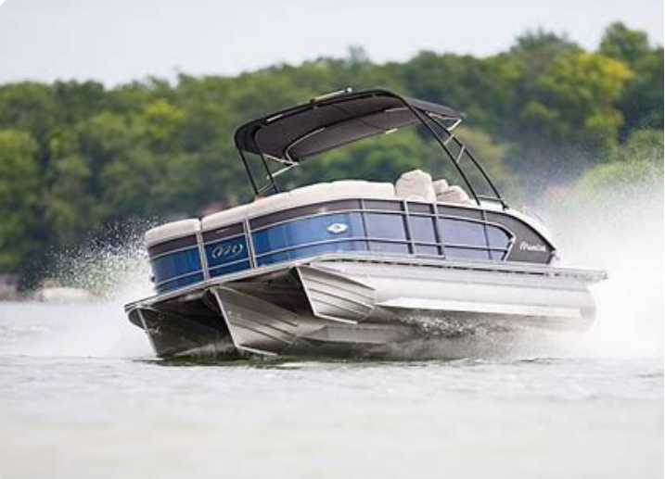
IH Good Boating Practices . . .
Accelerate you boat with a mindset to minimize wakes.
Be “Conscience of Plowing”
Be “Conscience of Turns”
Down person(s) hand up for safety
Tow skiers/tubing/wakeboarders away from shore areas
100-foot distance – tubing, skier
Returning to “Down Skier” with slow 180 turn
https://youtu.be/8_aw6xvbSA0?si=QI3QQmmVOJ9x8jSv
Turning
Plowing

Slide 12
Watersports Safety & Etiquette Workshop. . .
Thank You
Be Safe
Be Courteous
Be Conscious of Creating Waves
We encourage you to share the information with family, guests, and neighbors.

